Slide 1
Department of Chemical Engineering School of Studies, Engineering & Technology Guru Ghasidas Vishwavidyalaya, Bilaspur (A Central University) January 2020

Slide 2
VISION
The vision of the department is to establish itself as one of the best study center of Chemical Engineering with a focus on cutting edge technology research and to produce best Chemical Engineers to cater the needs of the society.

Slide 3
MISSION
The mission of the department is to provide quality and the state-of-the art education in Chemical Engineering and allied areas to produce career ready Chemical Engineers. To develop the research culture in fundamental and application oriented problems to foster industry-academia relationship

Slide 4
INTRODUCTION
Year of Establishment : 1997
Admission to B.Tech. : JEE (Mains)
P.G. Course started : 2012
Admission to M.Tech. : GATE,VET
Ph.D. Course started : 2016
Annual Intake : U.G. (75), P.G. (09)
Total Faculty Members : 11
Total Students : 117

Slide 5
FACULTY STRENGTH

Slide 6
FACULTY DETAILS
Name | Highest Qualification | Designation | Specialization | Experience (years)
Prof. (Dr.) S. N. Saha | Ph.D. | Professor | Fluidization Engg. | 40
Dr. Anil Kumar Chandrakar | Ph.D. | Associate Prof. | Catalysis, Reactive Separation | 13
Mr. Neeraj Chandraker | M. Tech. | Asst. Prof. | Water Purification | 18
Mr. Amit Jain | M. Tech. | Asst. Prof. | Membrane Separation | 14.5
Mrs. Anuradha Nanewaar Joshi | M. Tech. | Asst. Prof. | Reactive Extraction | 16
Mr. Saurabh Meshram | M. Tech. | Asst. Prof. | Water Purification, Modeling | 12.5
Dr. Raghwendra Singh Thakur | Ph.D., | Asst. Prof. | Adsorption, Process Intensification | 08
Mr. Gautam Prasad Dewangan | M. Tech. | Asst. Prof. | Computer Added Process & Equipment Design | 9.5
Mr. Vishnu Prasad Yadav | M. Tech. | Asst. Prof. | Catalysis, Renewable Energy | 07
Dr. (Mrs.) Ghoshna Jyoti | Ph.D. | Asst. Prof. | Process Intensification | 2.5
Dr. Sandeep Dharmadhikari | Ph.D. | Asst. Prof. | Membrane Technology | 0.5

Slide 7
CURRICULAM DESIGN & DEVELOPMENT
Based on the requirement of the current trend and Industrial need the curriculum is revised and upgraded regularly through Board of Studies (BOS), constituted by the University.
External Expert member in BOS : Prof. A. B. Soni, NIT Raipur.
Last BOS was held on 13th May 2019.
Vocational Training of 04 weeks is mandatory for the award of degree.
One minor project and one major project in VII and VIII semester respectively are inducted in the curriculum.

Slide 8
DIVERSITY OF THE CURRICULA
The Course curriculum includes the subjects from :
Core Engineering
Basic Engineering and Science
Management
 | Credits |  | Weightage (%)
 | UG | PG | UG | PG
Total credits | 190 | 60 | 100 | 100
Theory | 151 | 30 | 79.5 | 50
Laboratory/ Practical | 39 | 30 | 20.5 | 50

Slide 9
EXAMINATION SCHEME
DEPARTMENT OF CHEMICAL ENGINEERING
GURU GHASIDAS VISHWAVIDYALAYA, BILASPUR (C.G.)
(A Central University Established by the Central University Ordinance 2009, No. 3 of 2009)
SCHEME FOR EXAMINATION
B.Tech. (FOUR YEAR) DEGREE COURSE, CHEMICAL ENGINEERING
FOURTH YEAR, EIGHTH SEMESTER
S. No. | Course | Subject | Periods |  |  | Evaluation Scheme |  |  | Credits
 | Theory |  | L | T | P | IA | ESE | Total
01. | CH8TPC16 | Process Equipment Design - III | 3 | 1 | 0 | 40 | 60 | 100 | 4
02. | CH8TPC17 | Project Engineering Economics & Management | 3 | 1 | 0 | 40 | 60 | 100 | 4
03. | CH8TPE5X | Professional Electives -II | 3 | 1 | 0 | 40 | 60 | 100 | 4
04. | CH8TOE4X | Open Electives -II | 3 | 1 | 0 | 40 | 60 | 100 | 4
Practical
05. | CH8PPC10 | Project | - | - | 8 | 60 | 40 | 100 | 4
 |  |  | 12 | 4 | 8 |  |  | 500 | 20
IA – Internal Assessment ESE – End Semester Examination
Total Marks – 500 Total Periods – 24 Total Credits – 20

Slide 10
TEACHING LEARNING AND EVALUATION
Conventional class room teaching using blackboards as well use of semi smart class room
Teaching with the help of multimedia aids
Hands on laboratory practice
Tutorials
Industrial visit
Students’ Seminars

Slide 11
TEACHING LEARNING AND EVALUATION
Continuous evaluation system in each semester by Class Test, Mid Sem Exam and End Sem Examinations
Four weeks Vocational Training at the end of Sixth semester is mandatory for each student.
 | Weightage
 | Internal Assessment |  | End Sem Exam
 | CBCS | AICTE | CBCS | AICTE
Theory | 40% | 30% | 60% | 70%
Practical | 60% | 60% | 40% | 40%

Slide 12
STUDENT FEED BACK
Subject wise student feedback is carried out confidentially by university authority in each semester.
Based on the feedback from students, necessary improvement steps are taken.

Slide 13
FACULTY EVALUATION
Faculty member submits self appraisal report at the end of each academic session in the prescribed format supplied by University administration.

Slide 14
Grievance Redressal Mechanism
Mentoring system : Each faculty member is assigned as mentor for 15-20 students.
Students grievances are addressed at different levels :
Faculty in-charge (Semester wise)
Head of the department
Disciplinary committee member
Assistant Dean Students’ Welfare (ADSW)
Dean School of Studies
Dean Students’ Welfare (DSW)
Higher authorities of University Management

Slide 15
LIBRARY FACILITIES
Central Library (Common facility)
Institutional Library
Text Books : 2057
Reference Books : 120
Journals
Online : Springer, Cambridge University, Press, Emerald, Blackwell, Taylor & Francis, Elsevier etc.

Slide 16
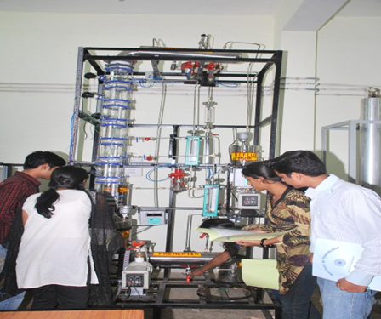
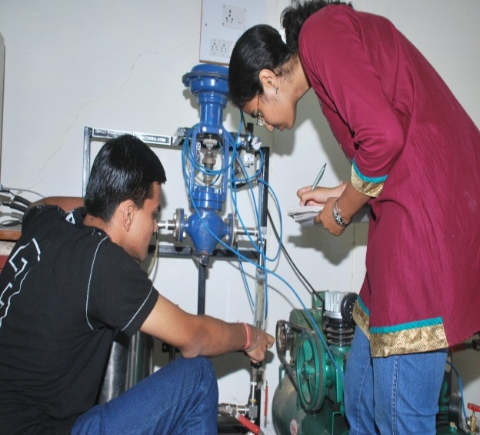
LABORATORY FACILITIES
Mass Transfer Lab
Name of Laboratory
Basic Chemical Engineering Lab
Fluid Mechanics Lab
Mechanical Operation Lab
Chemical Engineering Computational Lab
Heat Transfer Lab
Mass Transfer Lab (I & II)
Process Control Lab
Chemical Reaction Engineering Lab
Fuel Combustion Engineering Technology Lab
Instrumentation Lab
Process Control Lab

Slide 17
LIST OF MAJOR EQUIPMENTS
Gas Chromatograph
UV- Spectrophotometer
Distillation Unit
Heat Exchangers
BOD Incubator
Process Control Equipments
Interacting and Non-interacting system
Ion Exchange Equipment
Batch & Continuous reactors
Fluidized Bed Apparatus
Tray Dryer
Packed Bed Dryer
Absorption Unit
Size Reduction Equipments
Humidification & Dehumidification Apparatus
Hot Air Oven

Slide 18
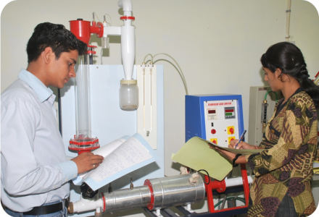
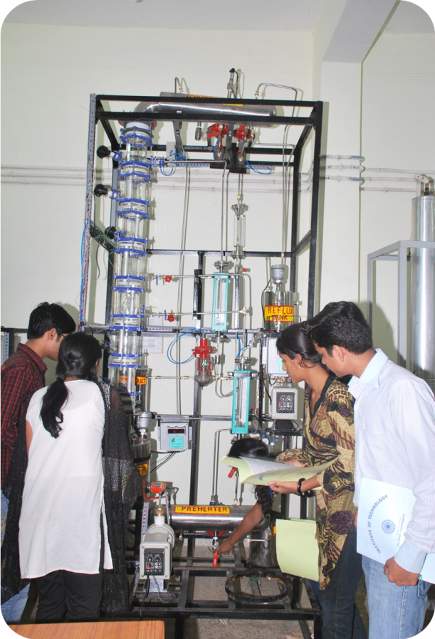
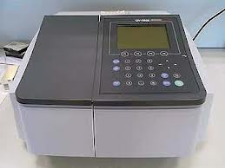
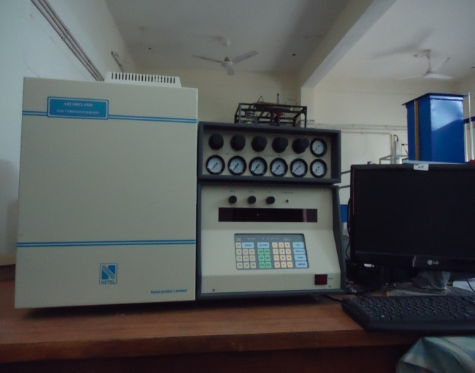
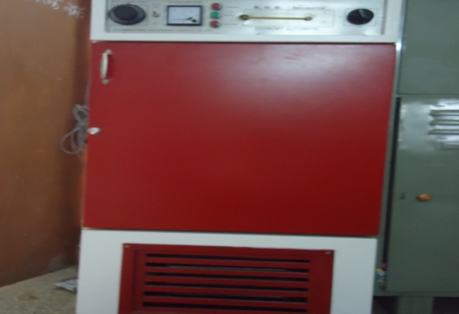
MAJOR EQUIPMENTS
UV Spectrometer
Photometer
Fluidized Bed Dryer
Gas Chromatograph
Distillation Column
BOD Incubator

Slide 19
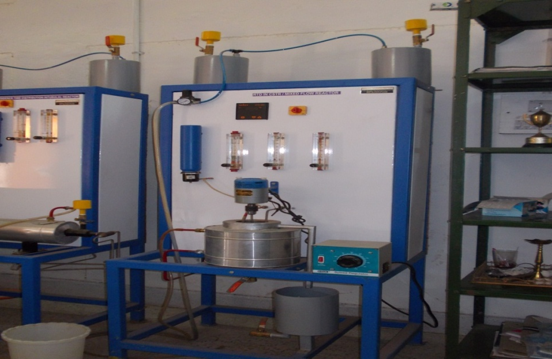
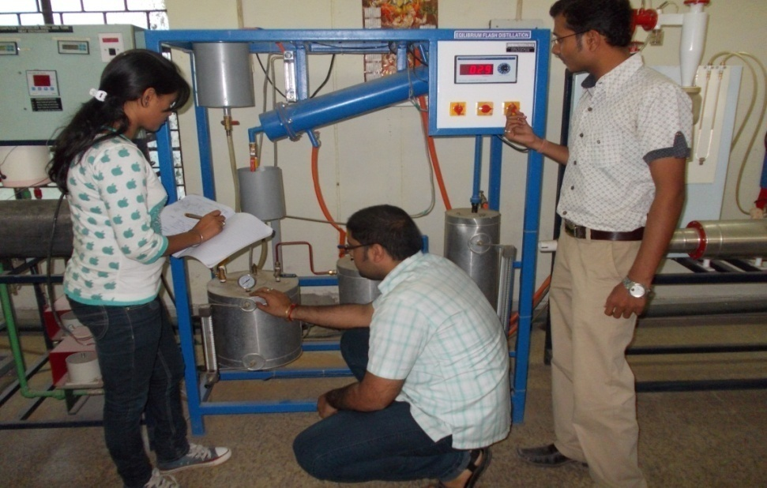
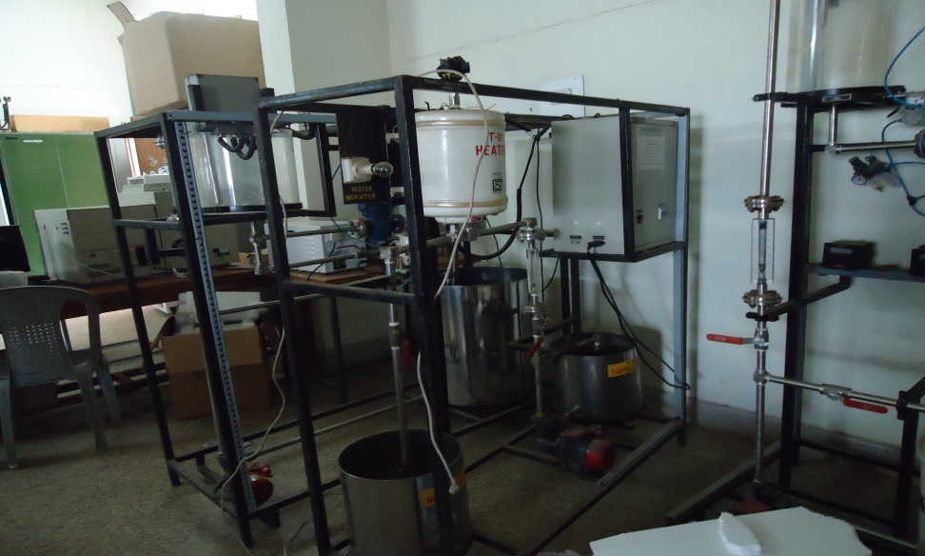
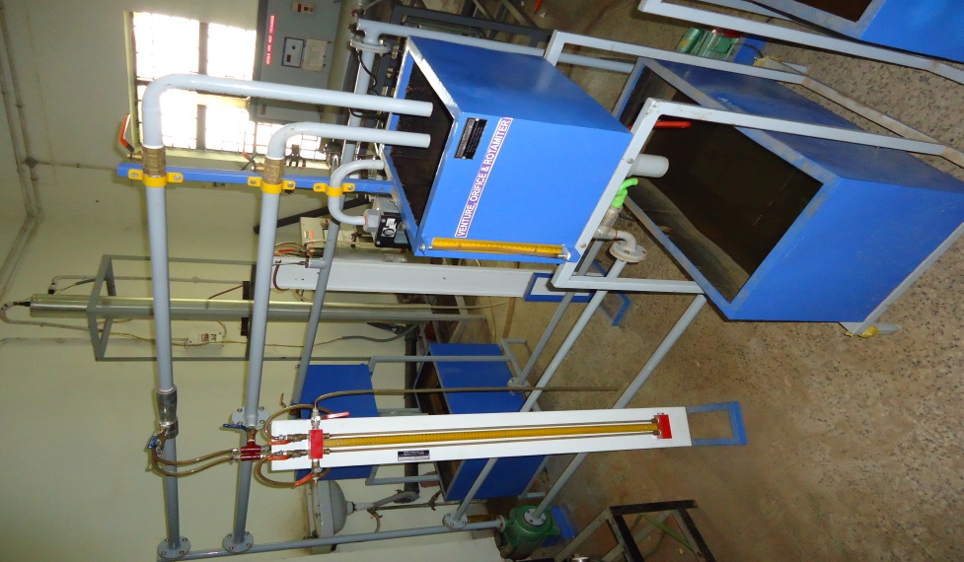
MAJOR EQUIPMENTS contd.
CSTR / Mixed Flow reactor
Flash Distillation
Temperature Controller
Venturi, Orifice and Rotameter

Slide 20
THRUST AREAS FOR RESEARCH
Fluidization Engineering
Catalysis
Reactive Separation & Extraction
Membrane Separation
Water Purification
Adsorption and Process Intensification
Computer Added Process & Equipment Design
Modeling and Simulation

Slide 21
RESEARCH PUBLICATIONS OVERVIEW

Slide 22
RESEARCH PUBLICATIONS
R. S. Thakur, N. Kaistha and D.P. Rao; “Novel single-bed and twin-bed pressure swing adsorption systems” Chemical Engineering and Processing: Process Intensification, 2015, 165-174.
P. Debashri, R. S. Thakur, and P. K. Chaudhari; "Simulation of FCC riser reactor using five lump model." International Journal of ChemTech Research, 2015, 750-758.
V. V. Desmukh, N. Chandraker, R. S. Thakur and A. K. Chandrakar; “Analysis of moisture content of pulses pellets using fluidized bed dryer” Journal of Chemical and Pharmaceutical Research, 2015, 7(6), 447-451.

Slide 23
RESEARCH PUBLICATIONS
4. A. Jain and S. De; “Aqueous extraction of bitter gourd (Momordica charantia) juice and optimization of operating conditions” Fruits, 2016, 71(6), 379-386.
A. K. Prajapati, P. K. Chaudhari, D. Pal, A. K. Chandrakar, R. Choudhary; “Electrocoagulation treatment of rice grain based distillery effluentusing copper electrode” Journal of Water Process Engineering, 2016, 11, 1–7.
V. P. Yadav, S. K. Maity and D. Shee; “Etherification of Glycerol with Ethanol over Solid Acid Catalysts: Kinetic Study Using Cation Exchange Resin” Indian Chemical Engineer, 2017, 59(2), 117-135.

Slide 24
RESEARCH PUBLICATIONS
7. S. Chatterjee, A. Jain and S. De; “Effect of different operating conditions in cloud point assisted extraction of thymol from Ajwain (Trachyspermum Ammi L.) seeds and recovery using solvent”, Journal of Food Science and Technology, 2017, 54(13), 4353-4361.
8. K. A. Ninga, S. Sengupta, A. Jain, Z. S. C. Desobgo, E. J. Nso and S. De; “Kinetics of enzymatic hydrolysis of pectinaceous matter in Guava juice”, Journal of Food Engineering, 2018, 221, 158-166.
9. A. Jain, S. Sengupta and S. De; “ Fundamental understanding of fouling mechanisms during microfiltration of bitter gourd (Momordica charantia) extract and their dependence on operating conditions”, Food and Bioprocess Technology, 2018, 11(5), 1012-1026.

Slide 25
RESEARCH PUBLICATIONS
10. S. Sengupta, A. Jain, and S. De; “Criteria for a unique steady state for enzymatic depectinization of bael (Aegle marmelos) juice in a continuous stirred tank reactor”, Reaction Chemistry & Engineering, 2018, 3, 333-343.
11. A. Jain, S. Sengupta and S. De; “Effect of process parameters on aqueous extraction of thymol and other phytonutrients from herbal seed Ajwain (Trachyspermum ammi L.), Journal of Applied Research on Medicinal and Aromatic Plants, 2018, 11, 27-36.

Slide 26
CONFERENCE PAPERS
A. Jain, “Optimization of Primary Extraction of Bitter Gourd (Momordica Charantia) Juice”, CHEMCON 2014, December 27-30, 2014.
R. S. Thakur, “Separation of CH4-N2 mixture using Pressure Swing Adsorption”, CHEMCON 2014, December 27-30, 2014.
N. Chandraker, “Equilibrium Studies of Hydroxy Acetic Acid by Adsorption Using Activated Charcoal” Innovative Trends in Computer Science & Information Technology, February 8-9, 2014.
N. Chandraker, “Kinetics Studies on the Adsorption of Glycolic Acid Using Various Adsorbents”, Innovative Trends in Computer Science & Information Technology, February 8-9, 2014.

Slide 27
CONFERENCE PAPERS
V. P. Yadav, “Gul (Tobacco Product) Manufacturing, Analysis its Components by Dimethyl Formaamide Using Spectrophotometer”, CHEMCON 2014, December 27-30, 2014.
A. Jain, “Alternate Rotating Tank Batch Reactor: A New Approach”, National Conference on ‘Innovation in Engineering’, February 27-28, 2015.
R. S. Thakur, “CO₂ Capture Using Ionic Liquid Impregnated Zeolite Adsorbent in a 4-Bed PSA Process”, CHEMCON 2015, December 27-30, 2015.
N. Chandraker, “Role of ICT in Multicommodity Exchange with Case Study (Crude Oil)”, National Seminar on Innovation and Research in Science, Management and Technology, March 29-30, 2015.

Slide 28
CONFERENCE PAPERS
9. A. Chandrakar, N. Chandraker, “A Review: Halophytes Used for Green Fuel Production”, National Seminar on Innovation and Research in Science, Management and Technology, March 29-30, 2015.
10. A. N. Joshi, “Extraction of Neem (AzardirachtaIndica) Oil Using Blends of Hexane, Ethyl Acetate and Acetone”, National Conference on Recent Advances in Biotechnology & Biofuels, September 12-13, 2016.
11. S. N. Saha, “Technical Institute and Industry Interaction through Total Quality Management-A Rejuvenate Approach”, International Conference on Bharat Rejuvenation, October 15-17, 2017.

Slide 29
CONFERENCE PAPERS
12. S. N. Saha, “Detailed analysis of extracted concrete from Murraya Koenigii” 3rd International Conference on Bioenergy Environmental and sustainable Technology, January 28-31, 2015.
V. P. yadav, “Evaluation of Convergence time in Manet Using Proposed Algorithm”, International Conference on Bharat Rejuvenation, October 15-17, 2017.
S. Meshram, “Adsorption Study of Resorcinol onto Iron Impregnated Granular Activated Carbon” CHEMCON-2017, December 27-30,2017.

Slide 30
CONFERENCE PAPERS
15. A. Jain, “Modern Pedagogy in New Era for Teachers and Students”, International Conference on ‘Quality Enhancement of Higher Education in India & Changing Paradigm, January 4-5, 2018.
16. A. Jain; “Membrane Technology : A Novel Approach in Food Processing”, National Conference on ‘Indigenous Foods : How to Promote it, April 19-20, 2018.
17. A. Chandrakar, A. N. Joshi, “Applications of Reactive Extraction in Food Industries : A Review”, National Conference on ‘Indigenous Foods : How to Promote it, April 19-20, 2018.

Slide 31
CONFERENCE PAPERS
18. G. P. Dewangan, “Simultaneous Saccharification & Fermentation of Ethanol From Potato Using Saccharomyces Cerevisiae and Bloom Algea”, CHEMCON-2018, December 27-30, 2018.
19. V. P. Yadav, “Catalytic Esterification of N-Butyric Acid with Ethanol over Zeolite Supported Nickle Catalyst and Sulphuric Acid”, CHEMCON-2018, December 27-30, 2018.
20. G. P. Dewanngan, “Study on circulating fluidized bed system for incineration of municipal solid waste with coal as an auxiliary fuel”, CHEMCON-2018, December 27-30, 2018.

Slide 32
CONFERENCE PAPERS
A. N. Joshi, “Reactive Extraction of p-Coumaric Acid Using TBP and Natural Diluents”, CHEMCON-2018, December 27-30, 2018.
S. Meshram, “Lead Removal from Battery Recycling Unit Wastewater by Adsorption onto Steam Activated Coconut Shell Granular Activated Carbon”, International Conference on Advances and Challenges for Sustainable Ecosystem, December 6-8, 2018.
S. Meshram, “Removal of Lead from Battery Recycling Unit Wastewater by Adsorption onto Nitric Acid impregnated Granular Activated Carbon”, CHEMCON-2018, December 27-30, 2018.

Slide 33
SHORT TERM COURSE / WORKSHOP ATTENDED
Two-day workshop on “Protection of Copyright and Patent” at IIT Kharagpur on during February 21-22, 2015.
One Day Workshop on “Exploratory Data Analysis” at IIT Kharagpur on March 14, 2015.
Recent Advances in Energy Research during March 23-27, 2015.
UGC-Sponsored Refresher Course in Chemistry & Chemical Technology at HRDC GGV Bilaspur during May 01-21, 2015.
One week Faculty Development Programme on Design of Software Metrics for Effective Software refactoring at Vishakhapatnam during December 29, 2015 to January 02, 2016.

Slide 34
SHORT TERM COURSE / WORKSHOP ATTENDED
6. Exposure on MATLAB at NITTR Kolkata during December 28, 2015 to January 08, 2016.
7. Nonlinear Systems : Mathematical Modelling and Computer Simulations” at NIT Raipur during January 4-8, 2016.
Intellectual Property Rights, IP Commercialization and Prevention of Plagiarism at GGV Bilaspur during January 26-27, 2016.
Mathematical Modeling and Computational Techniques in Science and Engineering at NIT Raipur during March 14-18, 2016.
Short Term Course on “Effective Communication Skill for Engineers, Scientists and Educators” at IIT Kharagpur during April 2-9, 2016.

Slide 35
SHORT TERM COURSE / WORKSHOP ATTENDED
11. SAKSHAM-IT Champion Training Program at HRDC GGV, Bilaspur during May 09-14, 2016.
12. UGC-Sponsored 16th Orientation Programme at HRDC GGV, Bilaspur ; from May 30 to June 25, 2016.
Workshop on “Reference Manager: Use of MENDELEY & ENDNOTE” at IIT Kharagpur on September 8, 2016.
Workshop on “Product Engineering and Design Idea Competition” at IIT Kharagpur on November 13, 2016.
One day workshop on Recent Challenges & Opportunities in Chemical Engineering at NIT Raipur on January 30, 2017.
Massive Open Online Courses (MOOCs) Training Programme at HRDC GGV, Bilaspur during February 27-28, 2017.

Slide 36
SHORT TERM COURSE / WORKSHOP ATTENDED
UGC-Sponsored 18th Orientation Programme at HRDC GGV, Bilaspur ; from May 01-29, 2017.
LATEX workshop on Technical Report Writing at IIT Kharagpur on May 24, 2017.
UGC-Sponsored Refresher Course in Advances in Engineering & Technology at HRDC GGV, Bilaspur ; from June 5-24, 2017.
One day workshop on “Forecasting Contaminant Percolation through Soil Beds in India” at IIT Kharagpur on September 12, 2017.
AICTE-QIP Short Term Course on Numerical Techniques for Chemical Process Simulations at IIT Kharagpur during November 20-26, 2017.

Slide 37
SHORT TERM COURSE / WORKSHOP ATTENDED
22. UGC-Sponsored 21st Orientation Programme at HRDC GGV, Bilaspur ; from June 04-30, 2018.
UGC-Sponsored Refresher Course in Research Methodology at HRDC GGV Bilaspur during June 16 – July 06, 2018.
Faculty Development Program for Student Induction at Pt. Ravishankar University, Raipur during January 12-14, 2019.

Slide 38
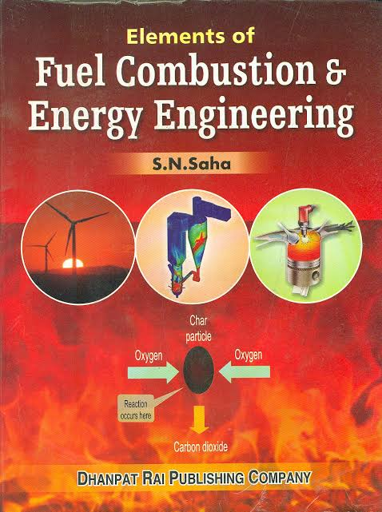
ACHIEVEMENTS OF FACULTY MEMBERS
Prof. S. N. Saha, Expert Member of the Scrutiny Committee, Appellate Committee and Approval Committee of AICTE, also expert member of National Board of Accreditation (NBA), NAAC.
Prof. S. N. Saha, authored one book in the year 2014 entitled
“Elements of Fuel Combustion & Energy Engineering”
Dhanpat Rai Publishing Co., Delhi
(ISBN- 81-87433-34-5)

Slide 39
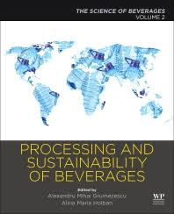
ACHIEVEMENTS OF FACULTY MEMBERS
Mr. Amit Jain (Assistant Professor) authored a book chapter entitled “Processing of Beverages by Membranes”.
This chapter published in
Processing and Sustainability of Beverages
Volume 2: The Science of Beverages
Published by
Woodhead Publishing, Elsevier
Paperback ISBN: 9780128152591
eBook ISBN : 9780128156995

Slide 40
ACHIEVEMENTS OF FACULTY MEMBERS
Dr. Raghwendra Singh Thakur (Assistant Professor) appointed as Reviewer in American Journal of Chemical Engineering
Dr. Raghwendra Singh Thakur (Assistant Professor) Chaired a Session on CHEMCON-2018 during December 27-30, 2018 at NIT Jalandhar.
Mr. Vishnu Prasad Yadav (Assistant Professor) Chaired a Session on CHEMCON-2018 during December 27-30, 2018 at NIT Jalandhar.
Dr. Raghwendra Singh Thakur (Assistant Professor) delivered a Expert Lecture during National Workshop on “Advances in Non-Conventional Energy Sources” at Rungta College Bhilai during December 23-24, 2015.

Slide 41
ACHIEVEMENTS OF FACULTY MEMBERS
Prof. S. N. Saha has chaired the technical session on ‘Bhartiya Concept of Sustainable Development’ of the International Conference on ‘Bharat Rejuvenation’ held in Guru Ghasidas Vishwavidyalaya, Bilaspur, during 15-17 October, 2017.
Prof. S. N. Saha chaired a technical session in National Conference on “Indigenous Foods: How to Promote it” during 19-20 April 2018 organized by Department of Food Processing & Technology, Bilaspur University (Now Atal Bihari Vajpayee Vishwavidyalaya), Bilaspur.

Slide 42
ACHIEVEMENTS OF FACULTY MEMBERS
Prof. S.N. Saha being a resource person has delivered many lectures in different Orientation Programme and Refresher Courses conducted by HRD Center, Guru Ghasidas Vishwavidyalaya, Bilaspur.

Slide 43
DEPARTMENTAL ACTIVITIES
Department conducted Chem-O-Philia quiz competition. It is a national level quiz competition conducted every year by the chemical engineering department, IIT Bombay as a part of their chemical engineering technical festival Azeotropy.
Department organized Industrial visit regularly for Second and Third year students of the department. The purpose of this visit was to increase the practical knowledge about Chemical Engineering process and unit operations.
Department have its own students’ society Chemical Engineering Students Society (ChESS).

Slide 44
STUDENTS ACHIEVEMENTS
37selection in GATE in last five years.
Students selected in various PSU companies through GATE
27 selection through campus placement.
Mr. Himangshu Mondal, selected as visiting student and conducted a visiting study at Kyung Hee University, South Korea by joining the research group of their Chemical Engineering department.
Mr. Himangshu Mondal, has published two research papers in reputed (SCI / Scopus) Journal.

Slide 45
STUDENTS ACHIEVEMENTS
Ms. Ayushi Jha and Ms. Sakchhi Kumari have participated in 13th Annual Session of Students’ Chemical Engineering Congress, “SCHEMCON-2017” held at NIT Rourkela and won the Best Paper Award.
Ms. Ayushi Jha and Ms. Sakchhi Kumari have presented the paper in 9th International Congress of Environmental Research during February, 8-10, 2018, held at Amity University, Gwalior (M.P.) in collaboration with Journal of Environmental Research And Development (JERAD).

Slide 46
STUDENTS ACHIEVEMENTS
Mr. Neeteesh Kumar Kaushik and Mr. Himansu Gupta have filed Indian Patent for their work “A Hydrogenation Catalyst and a Process There of” carried out during vocational training at Department of Chemical Engineering, VNIT Nagpur.
Many students participated in various technical events at various Techfest(s) of different colleges/ University / Institutions and secured First /Second position.

Slide 47
STUDENTS ACHIEVEMENTS
Ms. Ranjita Das has won the event title of JOB FANTASY (A Mock Job fair to get a flavor of real world of recruitment), during EQUILIBRIO 2k18 in which TIME group has provided 100% scholarship (MBA Entrance coaching) apart from the prize money.
Mr. Vishal Srivastava, Swadesh Kumar Srivastava and Aditya Sunil Zalke have won the first prize (prize money 8000/-) in Chem-E-Car competition organized during EQUILIBRIO 2k18 at Guru Ghasidas Vishwavidyalaya, Bilaspur (C.G.).

Slide 48
BEST PRACTICES
E-books and notes are provided
Display of Monthly attendance
Showing of valued answer sheets to students
Aptitude and GATE practice tests
Tutorial classes and giving assignments
Doubts clearing classes
Previous lecture revision before the each lecture
Promote students towards research
Remedial Classes
Display of Model Answer
Personality development activities
Sports facility for students, NSS activity, Tech Fest etc. are also conducted

Slide 49
OTHER ACTIVITIES

Slide 50
OTHER ACTIVITIES

Slide 51
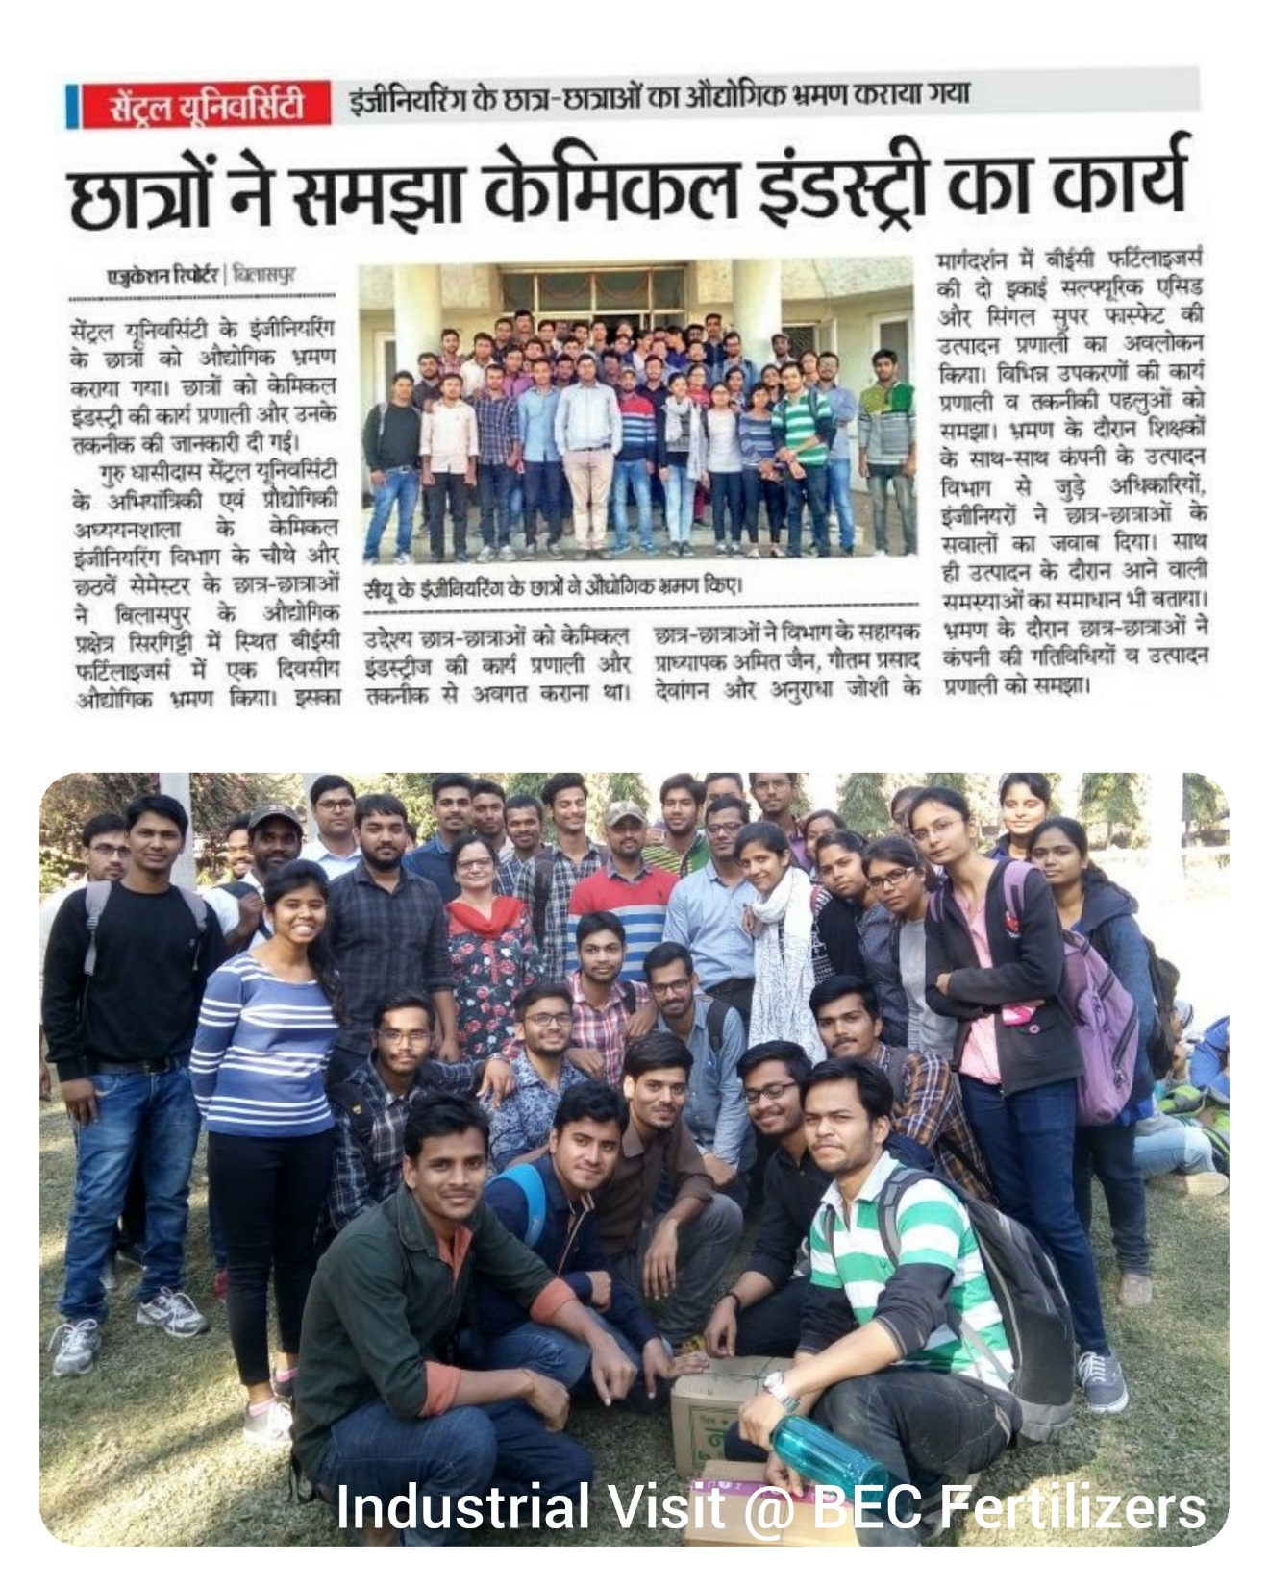
OTHER ACTIVITIES

Slide 52
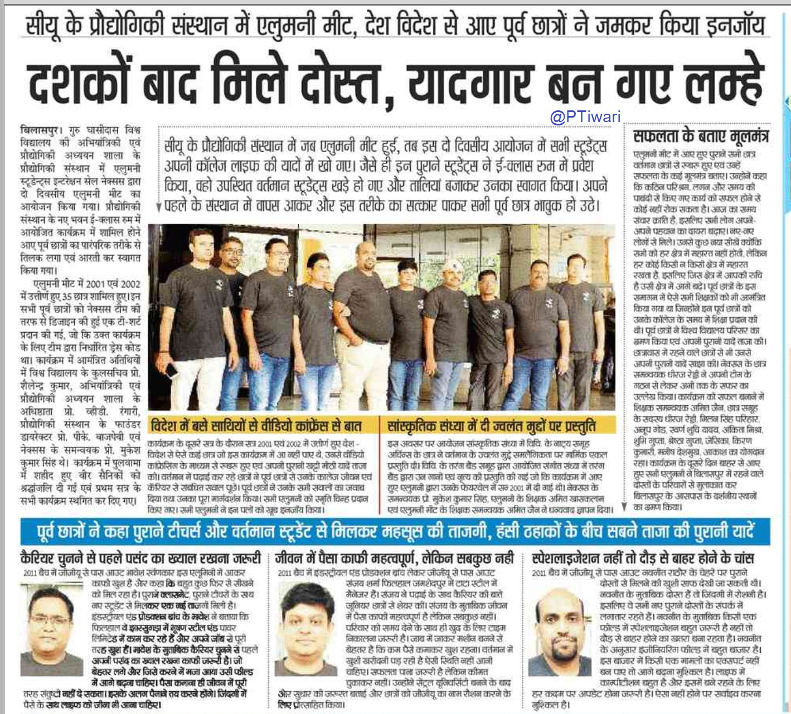
OTHER ACTIVITIES

Slide 53
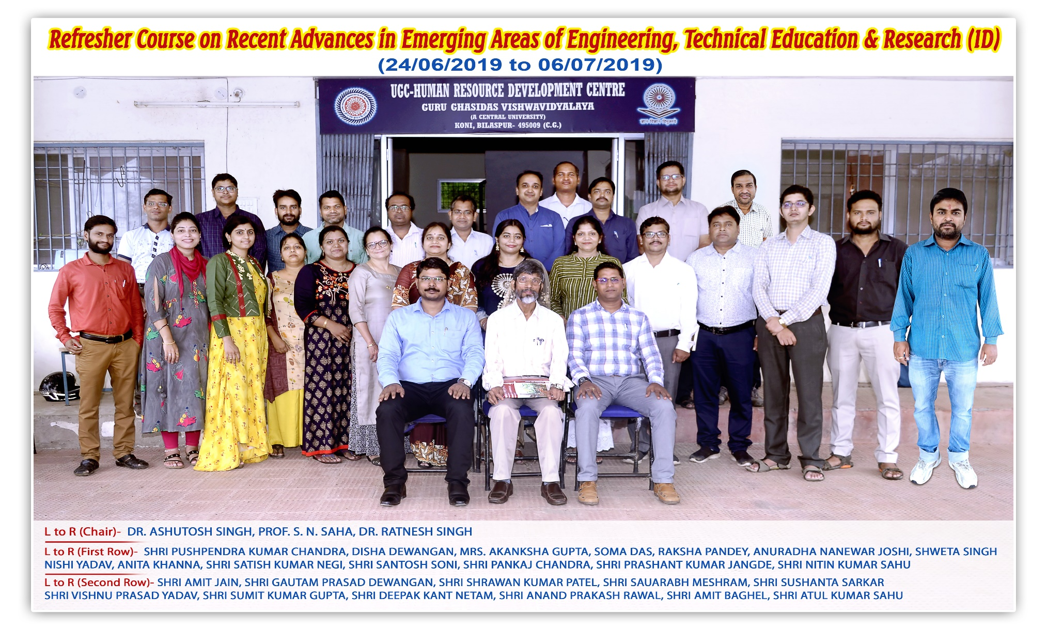
OTHER ACTIVITIES
Refresher Course

Slide 54
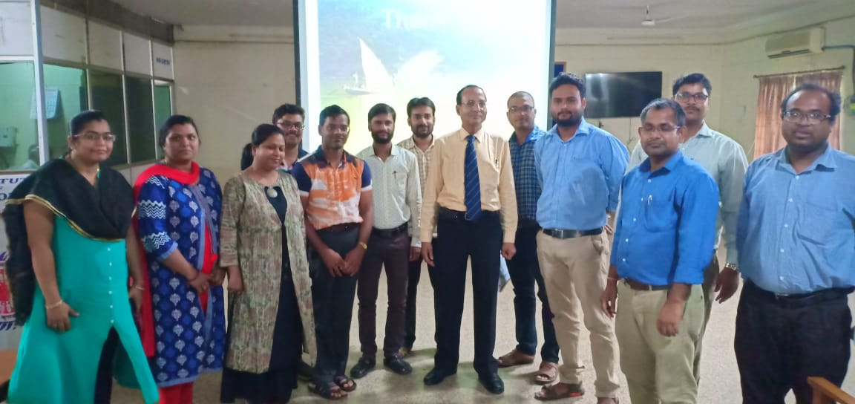
OTHER ACTIVITIES
Refresher Course

Slide 55
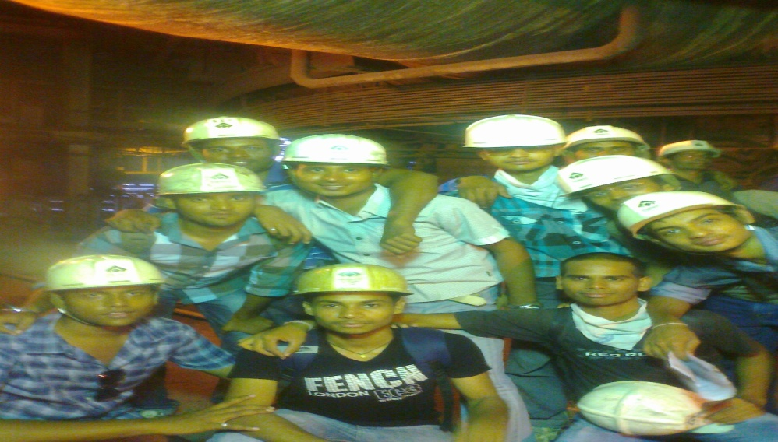
OTHER ACTIVITIES
Vocational Training

Slide 56
Thank You

